Slide 1


Challenge
Building a Podcast App
Amandine BARDIERE
18/11/2025

Slide 2



Learn
the CloudKit framework
Build
this podcast interface
Integrate cloud database with Swift

Slide 3

Async Operations
SwiftUI Integration
What is CloudKit ?
Framework
Containers

Slide 4
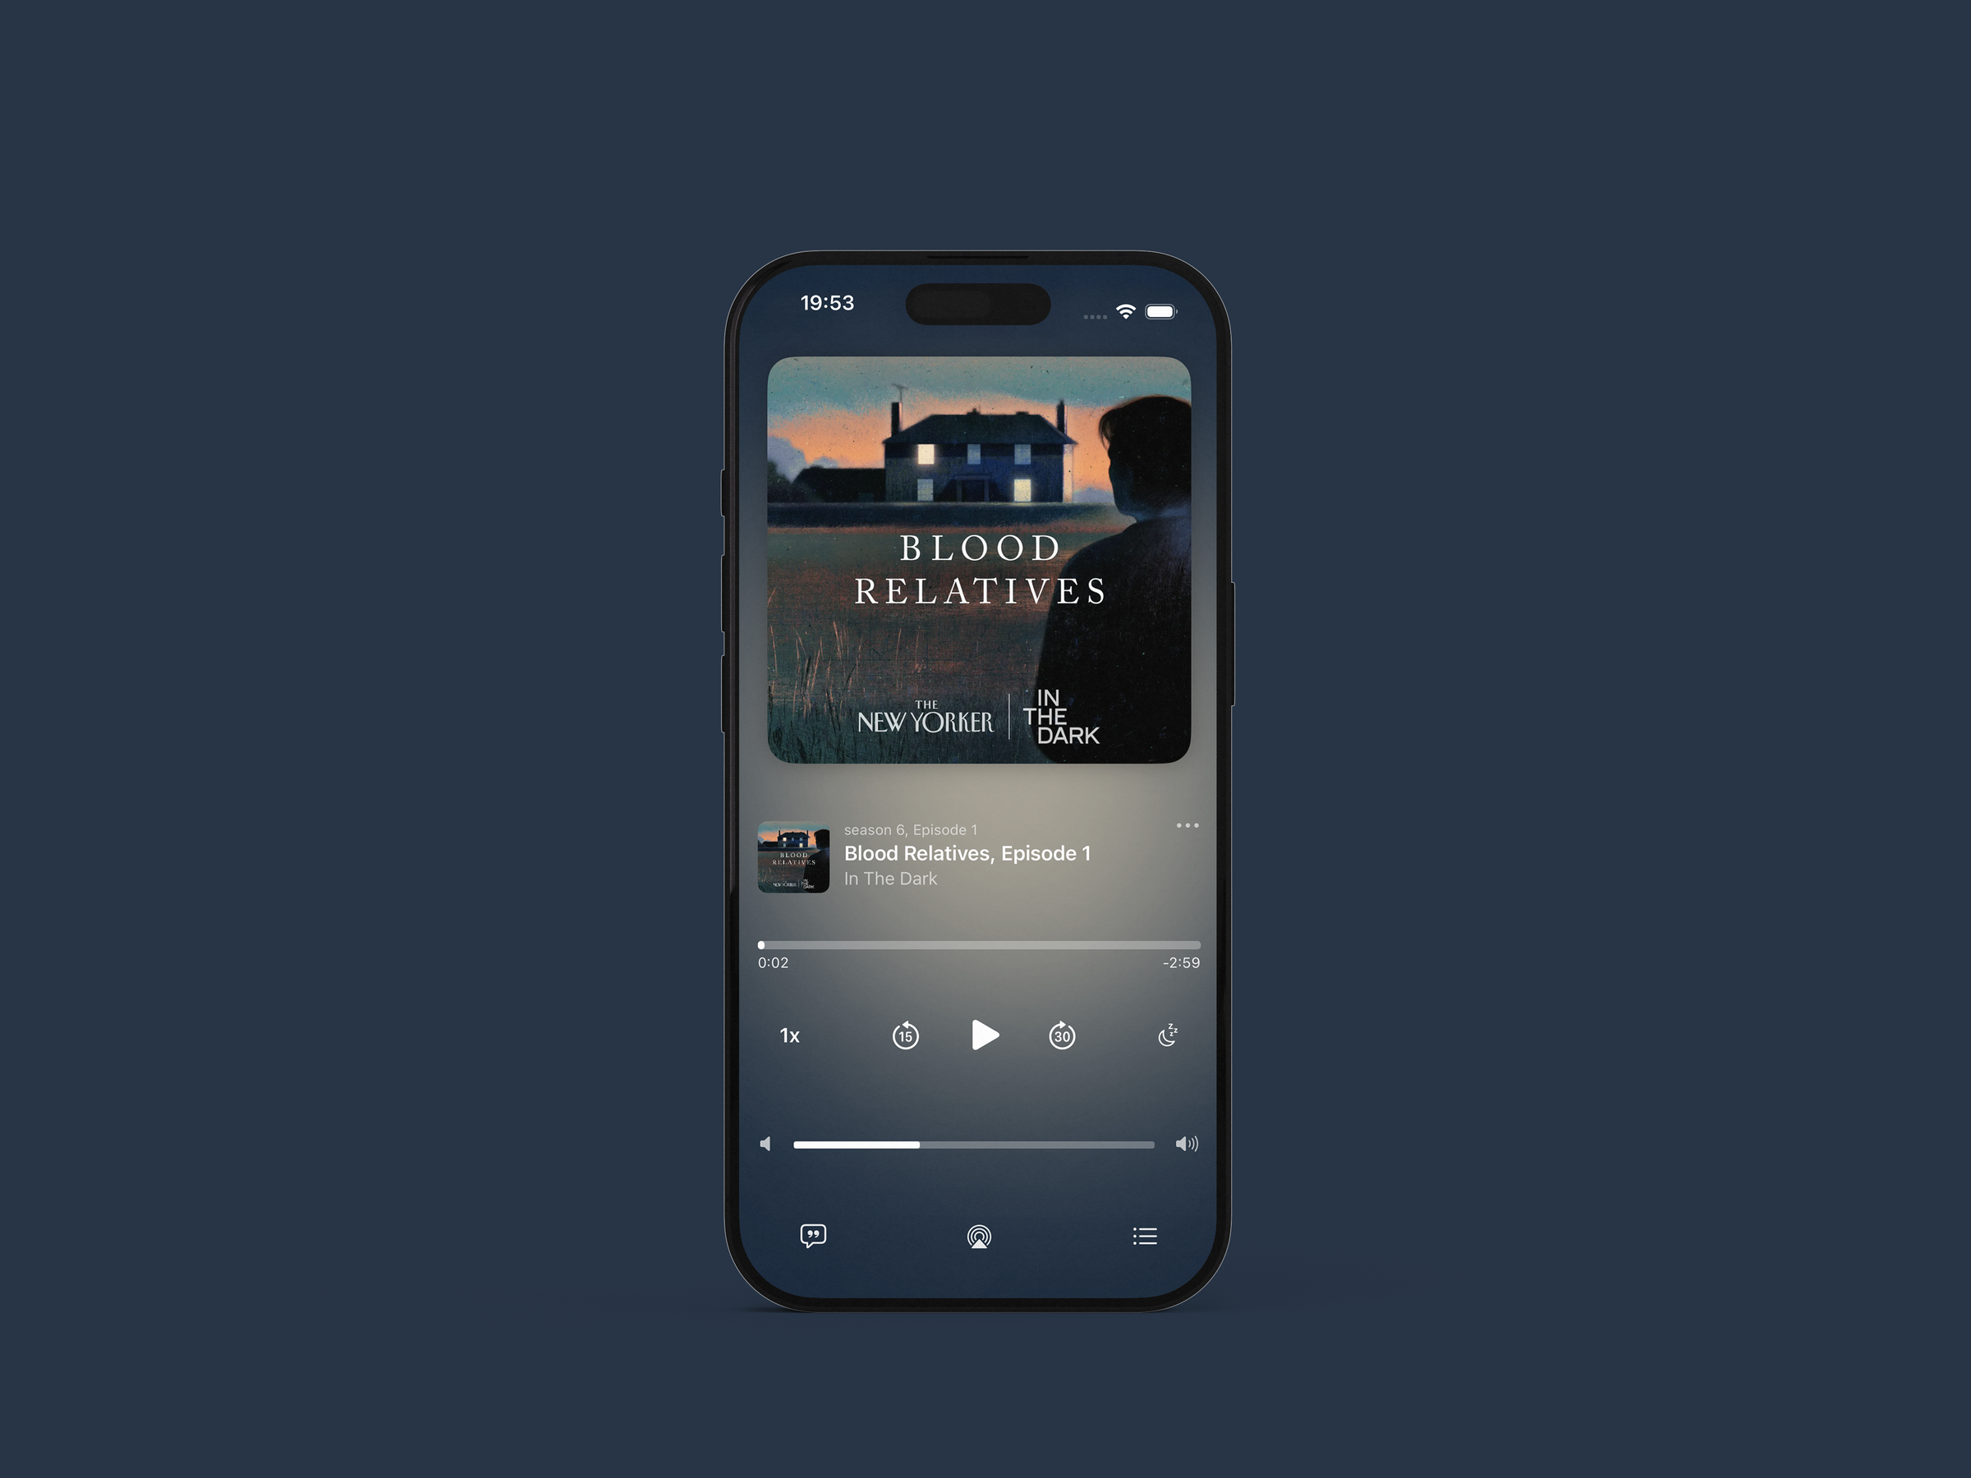
Learn CloudKit
Integrate Backend
  Containers & databases
  Record schemas
  Async queries
  Data retrieval
  Reactive updates
  Concurrency
Build Interface
  Audio player controls
  AVFoundation Audio
  Custom controls

Slide 5

Backend integration
Async programming
What I learned ?
Cloud architecture
Database design

Slide 6
Thank you

